Slide 1
Entering The Online Marketplace via Olist
MAR653 Final Project
Kristen Cheung, Cindy Khuu, Kenneth Kelly, Kyle Wojtaszek

Slide 2
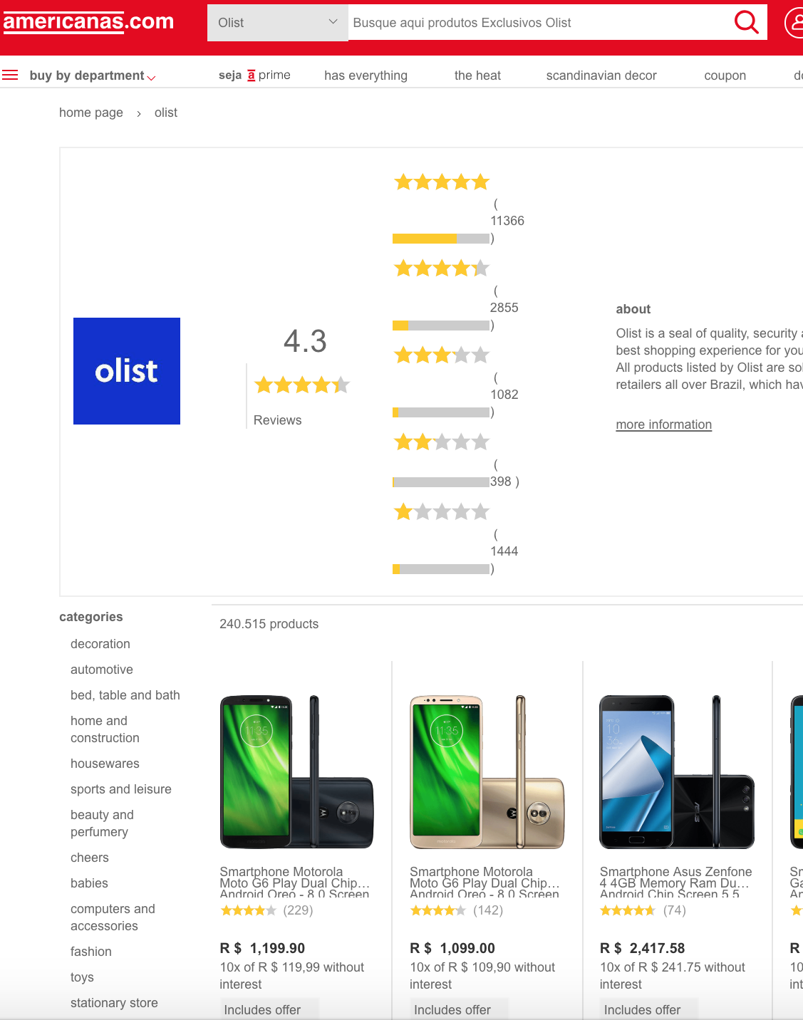
Executive Summary
Olist is the largest department store in Brazilian marketplaces. Allows merchants from small businesses throughout Brazil to sell their products and ship them directly to the customers through Olist’s logistics partners.
Identified six customer clusters based on basket size, freight, and review score with an opportunity to tailor more focus towards two of the largest segments DIY/ Tech and Home/Decor Customer
Identified four seller clusters based on the number of products listed, number of categories listed in, and average price of items. Used these clusters in tandem with customer clusters to determine best opportunities
Delivery experience overall has a large impact on review score with more negative experience likely results in lower scores and positive experienced likely results in positive scores

Slide 3
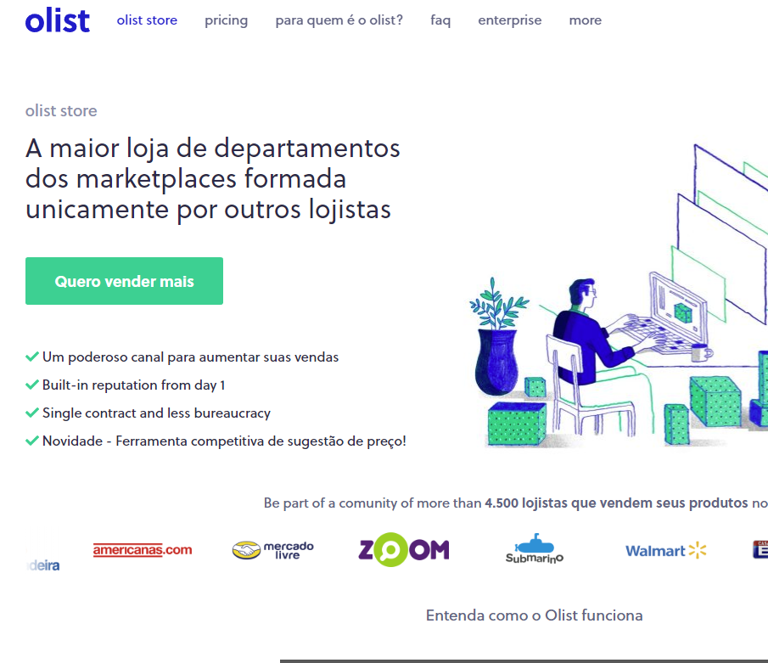
Business Overview – Olist
Olist is an e-commerce company based in Curitiba, Brazil
Brazilian version of Etsy’s marketplace for products
Founder Tiago Dalvi created Olist in 2015 with the goal of helping shopkeepers reach larger and the best marketplaces nationally and internationally.
Olist is among the Top 3 largest department store inside Brazil’s largest marketplaces and has generated $1.8 Million in revenue annually.

Slide 4
Research Objective
To better understand how to sell on platform in order to maximize success of a small businesses by:
Researching what types products are sold the most and who are buying them
Identifying opportunities via customer reviews and customer purchase history
Questions:
How to improve revenue with a new seller?
How to give a new vendor the best chance for success?
Who are our customers?
What makes a business successful today?
What drives a good customer review score?

Slide 5
Research Plan and Methodology
Data usage:
Customer reviews and score tied to product, order, and seller
Customer transaction level purchase history tied to product and seller
Product details: Units sold, unit price, product photo representation online
Sales and order fulfillment data from each seller
Difficulties with the data set:
Data set does not contain many repeat customers, so CLV calculations and determining what brings customers back was not possible
Review score text analysis did not provide novel insights
Bad reviews had negative words, good reviews had positive words
Finding an automated way to search through the linear regression results for the significant ones
Finding factors other than price that significantly affected sales, and outside of a few small pockets, there aren't really any good trends. Overall, as you would expect, for a given item, the lowest price generally sells the most.

Slide 6
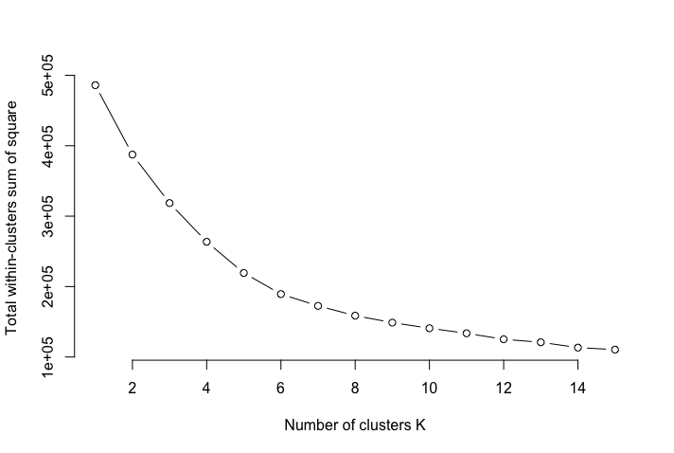
Clustering & Identifying Types of Customers
Used K-Means to identify 6 clusters based key traits to consider when a customer shops and the elbow plot:
Avg Sales $ Basket
The average dollar spent on each order can tell us how much they are willing to spend on each order. Are they higher basket dollar values or smaller dollar basket values?
Avg Unit Basket
The average units purchased can tell us how many units do they usually purchase. Do they purchase only one item, or do they purchase a lot of items? Do they purchase in bulk?
Avg Review Score
The average review score can indicate whether customers are satisfied or dissatisfied based on their previous shopping experience.
Number of Photos Available on Ordered Products
The number of photos tied to the products they purchase can tell us if some customers prefer to visually see photos of a products before making a purchasing decision.
Freight $ % of Total Ordered $
The percentage of freights from the total dollars spend on orders can help us indicate whether or not freight cost is a consideration when making a purchase since freight cost can vary at large with the distance between the seller and customer.
Elbow Chart

Slide 7
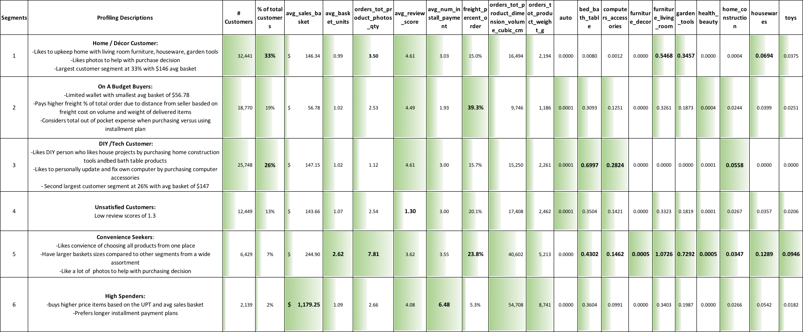
Customer Segmentations & Profiles

Slide 8
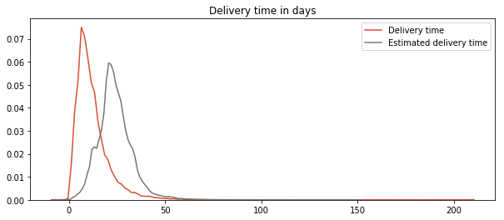
Delivery Expectations
The delivery time is based on when the product arrives to the customer’s home after placing an order.
The estimated delivery time was typically longer than the actual delivery time.

Slide 9
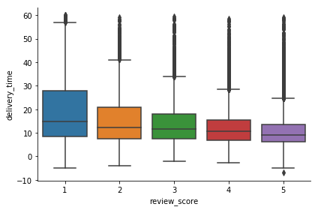
Delivery Time Effect on Customer Review
The longer the delivery time, the lower the review score.
Typically customers are better satisfied when receiving their product at a quicker rate

Slide 10
Understanding Customer Review Scores
Below shows the percent of each review score across the different shipment outcome classifications
For low review scores 1 & 2, Late Deliveries and Partial Deliveries have the highest penetration percent of these low scores.
For high review scores 4 & 5, Satisfied and Before Term have the highest penetration of these scores.
Overall, delivery outcome seems to have the largest impact on review scores depending if it’s a positive or negative experience.
Highest penetration of high scores
Definition Key
Late = Late delivery
Partial Delivery = Partial order was delivered
Delayed= Order was delayed
No Comment = No review as written
Low quality= customer thought product was low quality
Other delivery= order arrived with different delivery method
Another request= customer had to place another requested
Satisfied = satisfied customer
Before term= order came before expected delivery date
Highest penetration of low scores

Slide 11
What factors cause someone to choose a product listing?
Possible influences: Rating, Number of Photos, Price, Vendor ID
5,870 items from 1,442 vendors sold with more than one price point/photos/vendor ID combination
For each product, measure the percentage sold per listing for each combination
Linear regression to see what influences this percentage
Items sales percentage – Dependent variable
Rating, Number of Photos, and Price – Independent variables

Slide 12
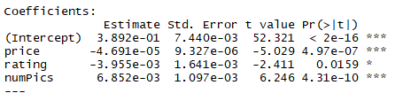

What factors cause someone to choose a product listing?
Price and Number of Pictures are significant contributors
As Number of Pictures goes up, sales go up
As Price goes down, sales go up
Rating has a much weaker significance
Still Important!
Overall Olist reputation
Access to features like Amazon’s Buy Box
Best avenue for customer feedback

Slide 13
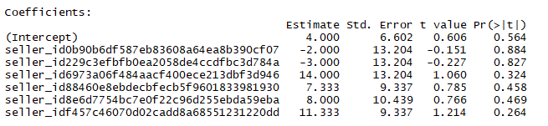
What about vendor?
For the products which had multiple vendors, we can look at each one individually and see if the vendor ID influences sales, again using linear regression
Among products sampled, vendor ID rarely had any effect.
When it did, this effect was cancelled out when including price, meaning that the reason it seemed effective was because that vendor consistently posted lower prices, not due to brand recognition.

Slide 14
What are properties of successful vendors on Olist?
3,033 unique vendors, generating 13.4 million Brazilian Reals in revenue
$3.4 million USD
Top 100 vendors generate approximately half of that revenue!
What makes them successful?
Can we connect their success to customer profiles to determine the right approach for a new entry into the market?

Slide 15
Seller Clustering - Setup
We will look at the top 100 sellers in our data set
As previously mentioned, these top 100 account for almost half the revenue from the entire data set of over 3000 sellers
We will cluster them based on three variables:
Average Price – Are they selling high priced items more likely to be low volume? Or are they loading up on many low-priced items?
Number of Categories Listed In – How broad are their offerings? Do they stick to a few specialized categories or go all over the place?
Products per Category – How deep are their offerings? Are they saturating a category, or just dabbling in each one?
Other variables were considered, but didn’t not offer much insight
Overall number of products – Weaker measure than normalizing by number of categories, as a seller with many categories also will have many items. Created collinearity.
Number of Photos and Avg Shipping Cost – Cluttering the data more and ultimately resulted in very similar clusters.

Slide 16
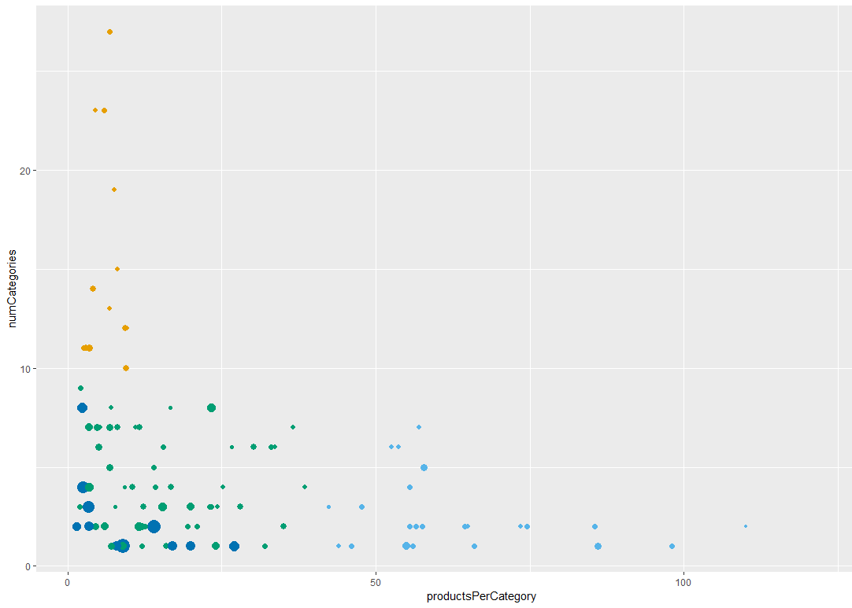
Seller Clustering - Results
Size of dot is relative to Average Item Price
Four distinct clusters, more details on future slides
Cluster 1 – Lots of categories, not many products per category
Cluster 2 – Small number of categories, lots of items per category
Cluster 3 – Moderate number of products and categories, lower prices. Relies on number of sales.
Cluster 4 – Small number of products and categories. Higher priced goods.

Slide 17
Seller Clusters – Result Verification
Vendor and Revenue distributions are very similar to each other
Each cluster is an equal opportunity to make good revenue, no inherit advantages in any cluster
Elbow Plot checks out

Slide 18
Cluster 1 – Unspecialized Businesses
Most popular categories:
Toys – 123 products
Watches/Gifts – 122
Computer Accessories – 121
Sports/Leisure – 98
Console Games – 94
Perfume – 82
Telephone – 65
Stationery – 59
Houseware – 55
Health/Beauty - 52
Cluster 1 contains vendors who are listed in 10 or more categories, but on average only have about 5-10 products per category.
13 of the top 100 sellers, representing 13.7% of revenue
Lots of categories which lend themselves to cheaper/generic merchandise
Toys, Watches, Computer Accessories, Stationery, Health/Beauty
Entertainment categories, more likely for impulse purchases or potentially scalpers of popular gifts
Sports/Leisure, Console Games, Toys
Relies on lower prices or impulse purchases to drive volume in order to support revenue stream
Easy access, but risky due to potentially small profit margins and large warehousing cost
Better for company with established supply chain

Slide 19
Cluster 2 – Specialized Businesses
Cluster 2 contains sellers who have upwards of 40 products in the categories they listed in. Most sellers here only list in 1-2 categories, maximum of 7
24 of the top 100 sellers, representing 26.0% of revenue
Interesting mix of categories
Some higher end products like Furniture, Appliances, and Auto
Some category where brand depth can play a role like Bed/Bath, Health/Beauty
Large number of products as each company is digging in on specific categories to own it
Difficult barrier to entry, as it most likely requires an established brand or an existing portfolio of offerings in a category
Most popular categories:
Bed/Bath – 990 products
Furniture – 585
Sports/Leisure – 348
Health/Beauty – 339
Home Appliances – 292
Watches/Gifts – 284
Telephone – 217
Auto – 192
Cool Stuff – 112
Office Furniture - 86

Slide 20
Cluster 3 – Low-Priced Well-Rounded Vendor
Most popular categories:
Watches/Gifts – 464 products
Computer Accessories – 302
Sports/Leisure – 255
Furniture – 230
Toys – 222
Stationery – 209
Housewares – 194
Office Furniture – 146
Baby – 128
Cool Stuff- 120
Cluster 3 contains sellers with a moderate amount of categories and products per category. Their products fall on the lower end of the price spectrum. These vendors make their high revenue by moving a lot of low-priced items.
52 of the top 100 sellers, representing 52.5% of revenue
Wider range of categories, less fall off in the popularity of categories
Intuitive mix of potentially lower priced goods like computer accessories, toys, stationery, housewares
Reasonable entry point, requires less knowledge/skill in certain category and since goods are low priced, extra stock won’t be as costly
Would require some supply chain investment however, key here is to move a lot of product

Slide 21
Cluster 4 – Highly Specialized Vendors
Most popular categories:
Health/Beauty – 48 products
Watches/Gifts – 44
Small Appliances – 19
Home Appliances – 13
Construction Tools – 12
Musical Instruments – 8
Toys – 5
Cool Stuff – 4
Sports/Leisure – 2
Auto - 1
Cluster 4 has a small amount of categories and products per category. This cluster tends to sell a lower volume of higher priced goods to support their high revenue streams.
11 of the top 100 sellers, representing 7.8% of revenue
Very small number of products, highly specialized
Luxury Goods: Expensive health/beauty products, watches
Special Use Goods: Appliances, Tools, Instruments
Seems like the best place for an established company to come in and sell online, not great for a new company
Brand recognition, low demand items

Slide 22
Conclusion – Selling on Olist
Price
Need to be competitive with pricing in the market
Place
Shipping – reduce delivery times and provide accurate estimations of delivery time
Service a large area of Brazil, affecting delivery time
A lot of remote areas in Brazil
Promotion
Marketing Communications – Photos
More photos, more products purchased
Description of the product – meaningful and accurate content
Product
Amount of products available
Wide range from food to electronics
Low brand awareness

Slide 23
Connecting Customer To Business
We can connect these seller clusters to our customer clusters in order to discover our best opportunity for starting a new business selling via Olist
High Spenders Customer cluster matches well with the Highly Specialized Business cluster
However, as mentioned, this is not a great space for a new business to enter.
Convenience Seeker Customer cluster matches well with the Unspecialized Business cluster
However, this is a small amount of customers (7%)
Two largest customers segments combined for 59% of customers
House/Décor Customers: Buys furniture, garden tools, other home products
DIY/Electronics: Bed/Bath, Computer Accessories, Tools
These two clusters match well with the Specialized and the Low-Priced Well-Rounded Businesses
Specialized – Often offers bed/bath, furniture, health/beauty, appliances
Low-Price Well-Rounded – Often offers computer accessories, furniture, housewares

Slide 24
Final Recommendation
Low-Priced Well-Rounded Vendor is probably the best model to follow to maximize the probability of success of small businesses, as it has a lower barrier to entry than the Specialized Business model.
Based on the overlap between our business cluster and our most popular customer clusters, our Low-Price Well-Rounded business should start by selling low-priced computer accessories, housewares, and smaller furniture items since these are good matches between customer demands and the typical items from these type of vendors
Our Low-Priced Well-Rounded business could potentially expand into bed/bath and low-priced tools. These are items our target customers demand, but aren’t as common from this type of vendor.
Over time, evolving a business from Low-Price Well-Rounded to a Specialized Business seems like a reasonable plan as your selling firm finds categories that they excel in.

